Slide 1
Computer Architecture: Memory Safety & Protection
Dr. Colin O’Flynn

Slide 2
Lectures
How does a program run on a machine?
How do you compile from high-level code to machine code?
How does the machine run? (Control Flow)
How does the machine store data?
How does the machine interface using buses?
What does it mean to have “allowed” memory?
How does the machine speed up data access?

Slide 3
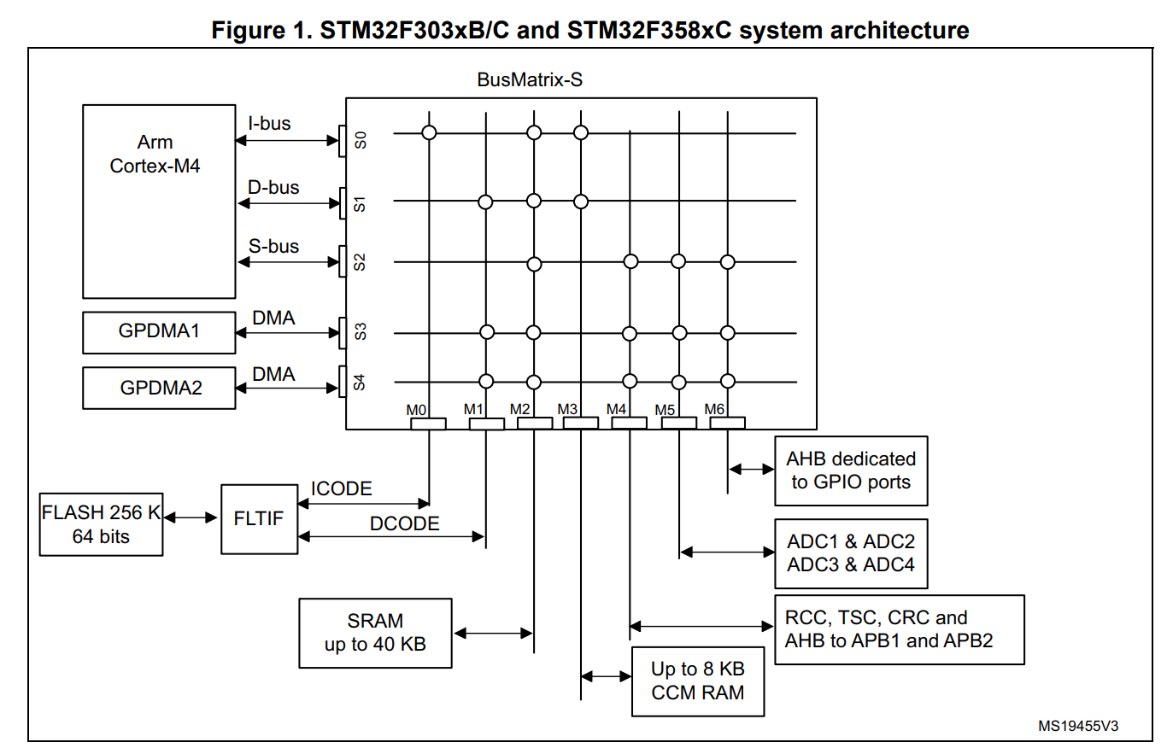
Busses that don’t respond or Invalid
Prior lecture looked at busses
This lecture will go beyond just “non-existent”

Slide 4
Memory Safety
Memory safety helps:
Protect against unintended natural events (bit-flips)
Protect against bugs that could cause dangerous operations
Protect against attackers exploiting the memory features

Slide 5
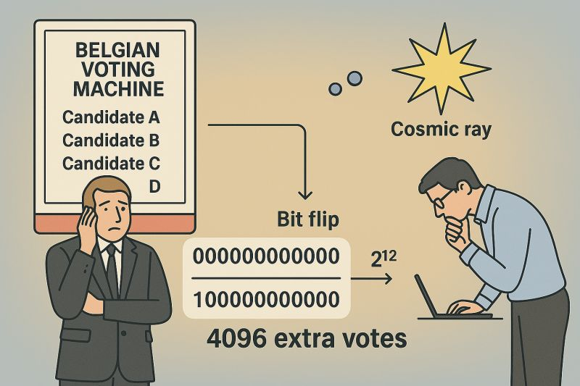
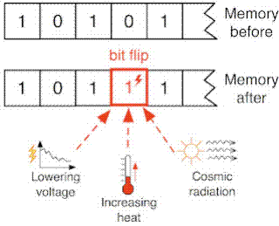
Memory Error Correction (ECC)
In 2003, a candidate in a Belgium election received 4096 extra votes… a suspicious number…

Slide 6
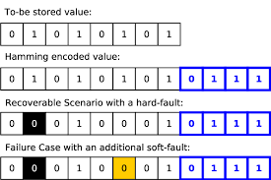
ECC Memory
Extra bits used to store data to determine if there is an error.
Can sometimes recover from a single bit-flip.
Question of how many bits to use in ECC vs. memory, as impacts efficiency.

Slide 7
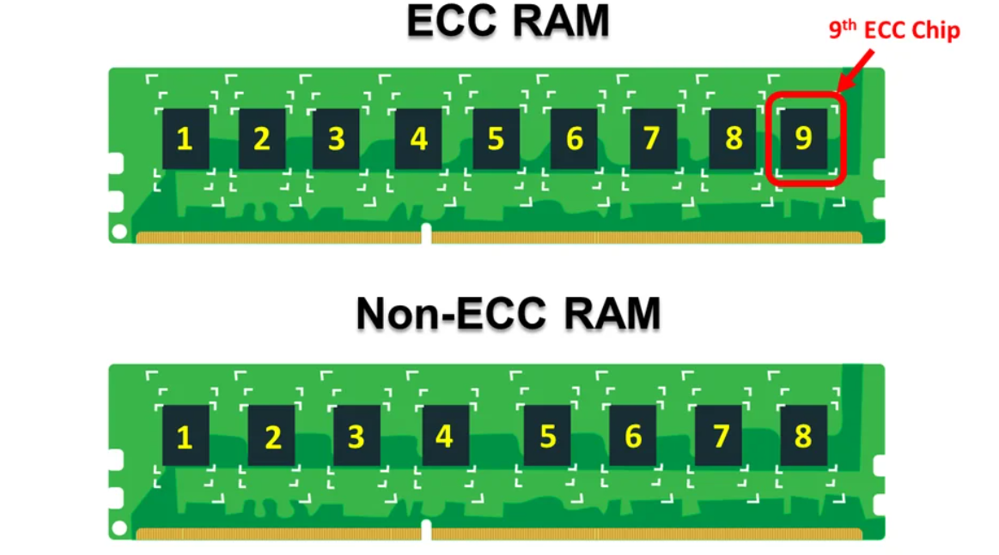
ECC Memory in Servers
Not just embedded systems – “server-grade” memory often has ECC.
Detects & can fix a certain number of bit flips.

Slide 8
Microcontroller ECC Memory
Certain memory types (FLASH memory) often contain ECC as they degrade with use. This will be (normally) hidden from you.
ECC memory in microcontroller RAM is relatively rare for general use.
Microcontrollers designed for safety-critical use (automotive) very likely to include these features.

Slide 9
Invalid Memory Access Problems
Memory corruption is one problem, but what about:
Microcontroller tries to write somewhere invalid?
Microcontroller tries to execute from an area that isn’t actually code?

Slide 10
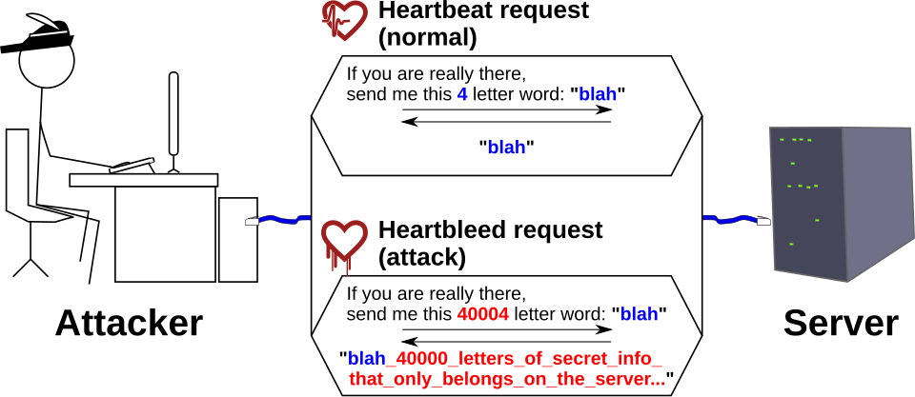
e.g., HeartBleed
https://commons.wikimedia.org/wiki/File:Heartbleed_bug_explained.svg

Slide 11
e.g., HeartBleed
https://commons.wikimedia.org/wiki/File:Heartbleed_bug_explained.svg

Slide 12
Memory Overwriting & Reading
Lots of examples of this in practice – but in general an attacker tries to write to or read from memory they should not be allowed to access.
Often an attacker wants to execute some buffer they have written a program to.

Slide 13
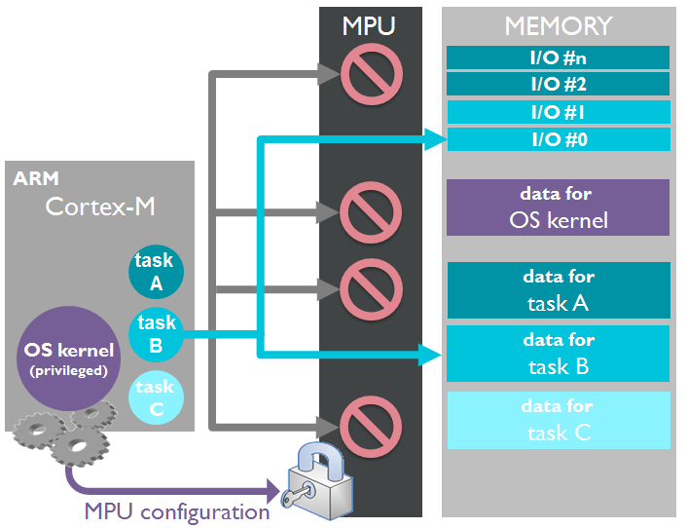
Hardware Memory Protection
Ideally each task would only have access to certain data.
The capabilities of the MPU depend on the device.
Minimum supports at least two modes

Slide 14
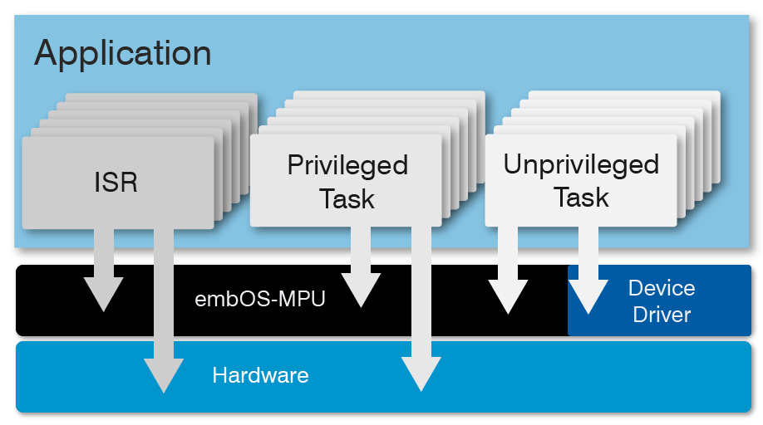
Privileged & Unprivileged Modes

Slide 15
Read / Write / Execute Permissions
Similar to on e.g., Linux:
Files can have permission for “read”, “write” and “execute”
Permissions can vary for owner or others (e.g., privileged vs. unprivileged)
MPUs enforce this over address spaces.
You need to carefully manage your address spaces to help with this.

Slide 16
Note: Harvard Architecture
Harvard architectures naturally enforce non-execute on data
Impossible in all cases to execute from the data region!
Arm by default allow execution from data region (even if you never use it).

Slide 17
Memory Access Logic
Access Regions
Address Relocation
Physical Memory
CPU Address
Check
+
FAIL: Trap

Slide 18
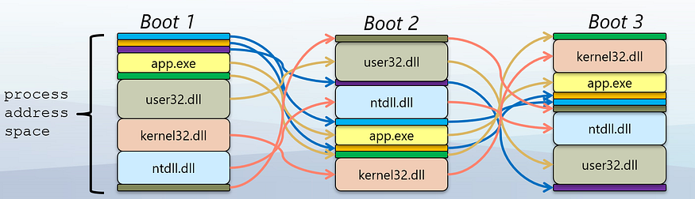
Address Space Layout Randomization (ASLR)
Now common on Oses (not microcontrollers) – randomly changes where processes are in memory
Makes it difficult (impossible) for attacker to exploit normal orders

Slide 19
MPU & MMU
MPU (Memory Protection Unit)
Normally part of microcontrollers
Fixed number of regions we can configure
MMU (Memory Management Unit)
Normally part of “application-class” processors (e.g., Running Linux/Android/Oses)
Address virtualization support, many additional features

Slide 20
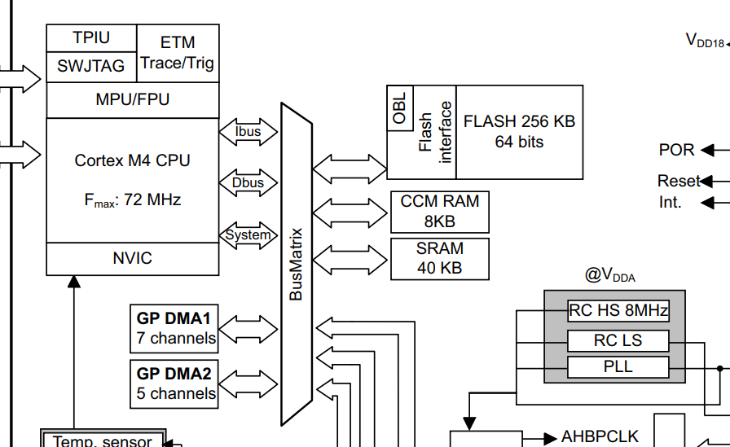
MPU Example
Note MPU is part of the core
DMA (another bus controller) is not bound by MPU!

Slide 21
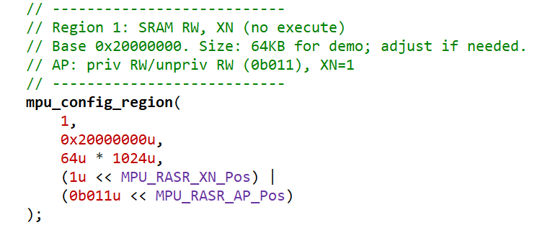
STM32F3 MPU Setup
E.g., disable execution from RAM

Slide 22
STM32 MPU Introduction
https://www.st.com/resource/en/application_note/an4838-introduction-to-memory-protection-unit-management-on-stm32-mcus-stmicroelectronics.pdf
https://www.st.com/resource/en/programming_manual/pm0214-stm32-cortexm4-mcus-and-mpus-programming-manual-stmicroelectronics.pdf

Slide 23
STM32 MPU Demo
<See Segger>

Slide 24
Memory Safe Languages
C is not memory safe as you can do this:
char buffer[8];
buffer[8] = ‘x’;
You may get a compiler warning in that case, but if passed as a pointer there would be no warning.
This is the exact bug type that caused the HeartBleed attack earlier.

Slide 25
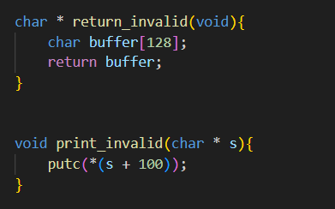
More Invalid C Demos

Slide 26
Memory Safe Languages
Hardware cannot prevent many of these problems – MPU would see them as valid.
Memory-safe language guarantees:
No buffer overflow
No use-after-free
No dangling pointers
No invalid pointer arithmetic

Slide 27
Memory Unsafe Language Hints
Generally memory-unsafe languages allow you to:
Directly manipulate pointers
Cast any value to any other value
Perform manual memory management

Slide 28
Memory Safe Languages
E.g., a few languages & how they achieve that goal:
Language | Approach
Java | Runtime checks
Python | Runtime checks
Go | Garbage collection
Rust | Compile-time safety
Swift | Strong type system

Slide 29
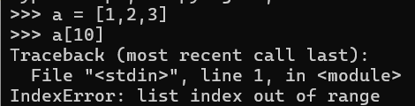
Runtime Memory Safety
Enforced at runtime – not detected until you try and execute the code:
Bounds checking
Null checks
Garbage collection
Type Safety

Slide 30
Compiler-Time Memory Safety
Rust prevents errors before execution
Perfect for embedded systems where can be difficult to see error lots.
Concepts of this mean tracking:
Ownership
Borrowing
Lifetimes

Slide 31
Rust Ownership Model
Every value was one owner.
Ownership can move.
References must following borrowing rules.
Lifetimes are checked and must be valid.
See next page for example

Slide 32
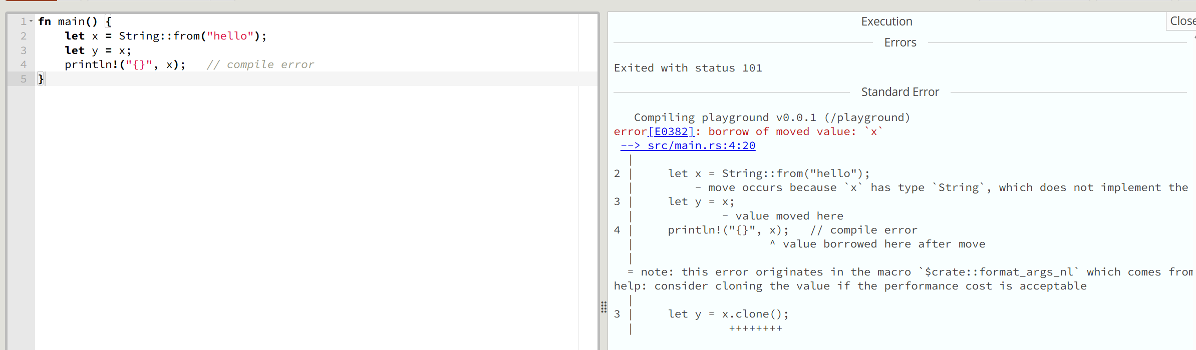
e.g., Rust compiling an error
https://play.rust-lang.org/?version=stable&mode=debug&edition=2024

Slide 33
Memory Safe CPU Architectures
New designs of processors try to enforce some of these concepts in hardware.
Capability Hardware Enhanced RISC Instructions (CHERI) and CHERIoT are two variants of this idea (higher & lower performance)
In CHERI pointers become capabilities:
Capabilities in hardware track address, bounds, permissions, and validity

Slide 34
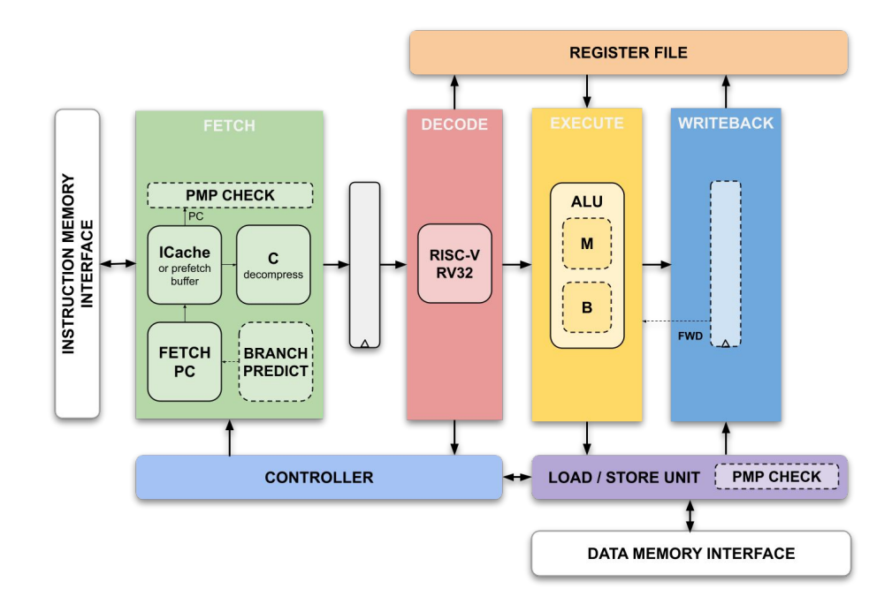
CPU Core: Initial

Slide 35
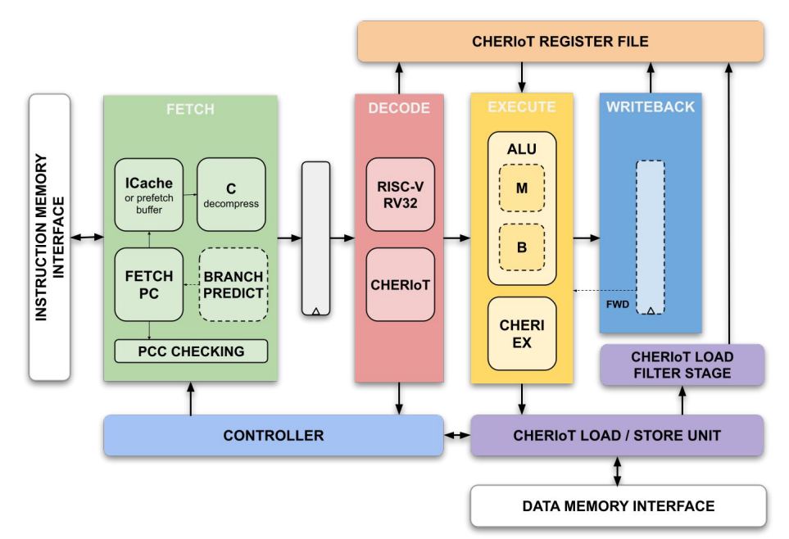
CPU Core: Initial

Slide 36
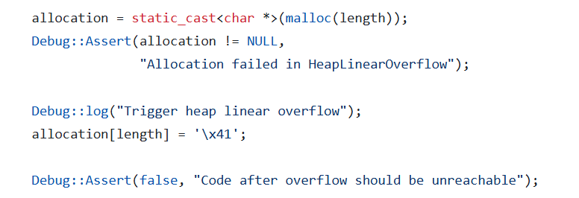
e.g., CHERIoT Code (Programmer View)
https://github.com/CHERIoT-Platform/cheriot-rtos/blob/main/examples/08.memory_safety/memory_safety_inner.cc#L69

Slide 37
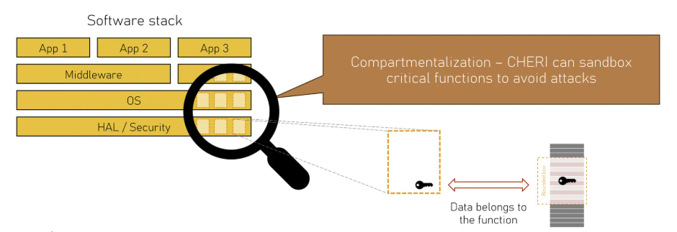
Other Features: Capabilities and Compartments

Slide 38
Hardware Enforced Memory Safety
Unlike with programming language, the code will not run.
Trade-off as may want to determine this at compile-time when that could be know.
Analysis tools can also determine this, leading to “best of both worlds”
CHERIoT is new – first physical devices demonstrated this year, but active development
May be something you run across later in your career!

Slide 39
Memory Safety Summary
Memory safety normally refers to preventing “out of bounds” access.
Often presents a security risk, but also a safety risk if e.g., crashing program causes a physical device to misbehave.
Memory Protection Unit (MPU) is most commonly used device in smaller microcontrollers to enforce region level access.
Memory-safe languages (such as Rust) and architectures (such as CHERIoT) gaining wider acceptance in embedded.

